Slide 1
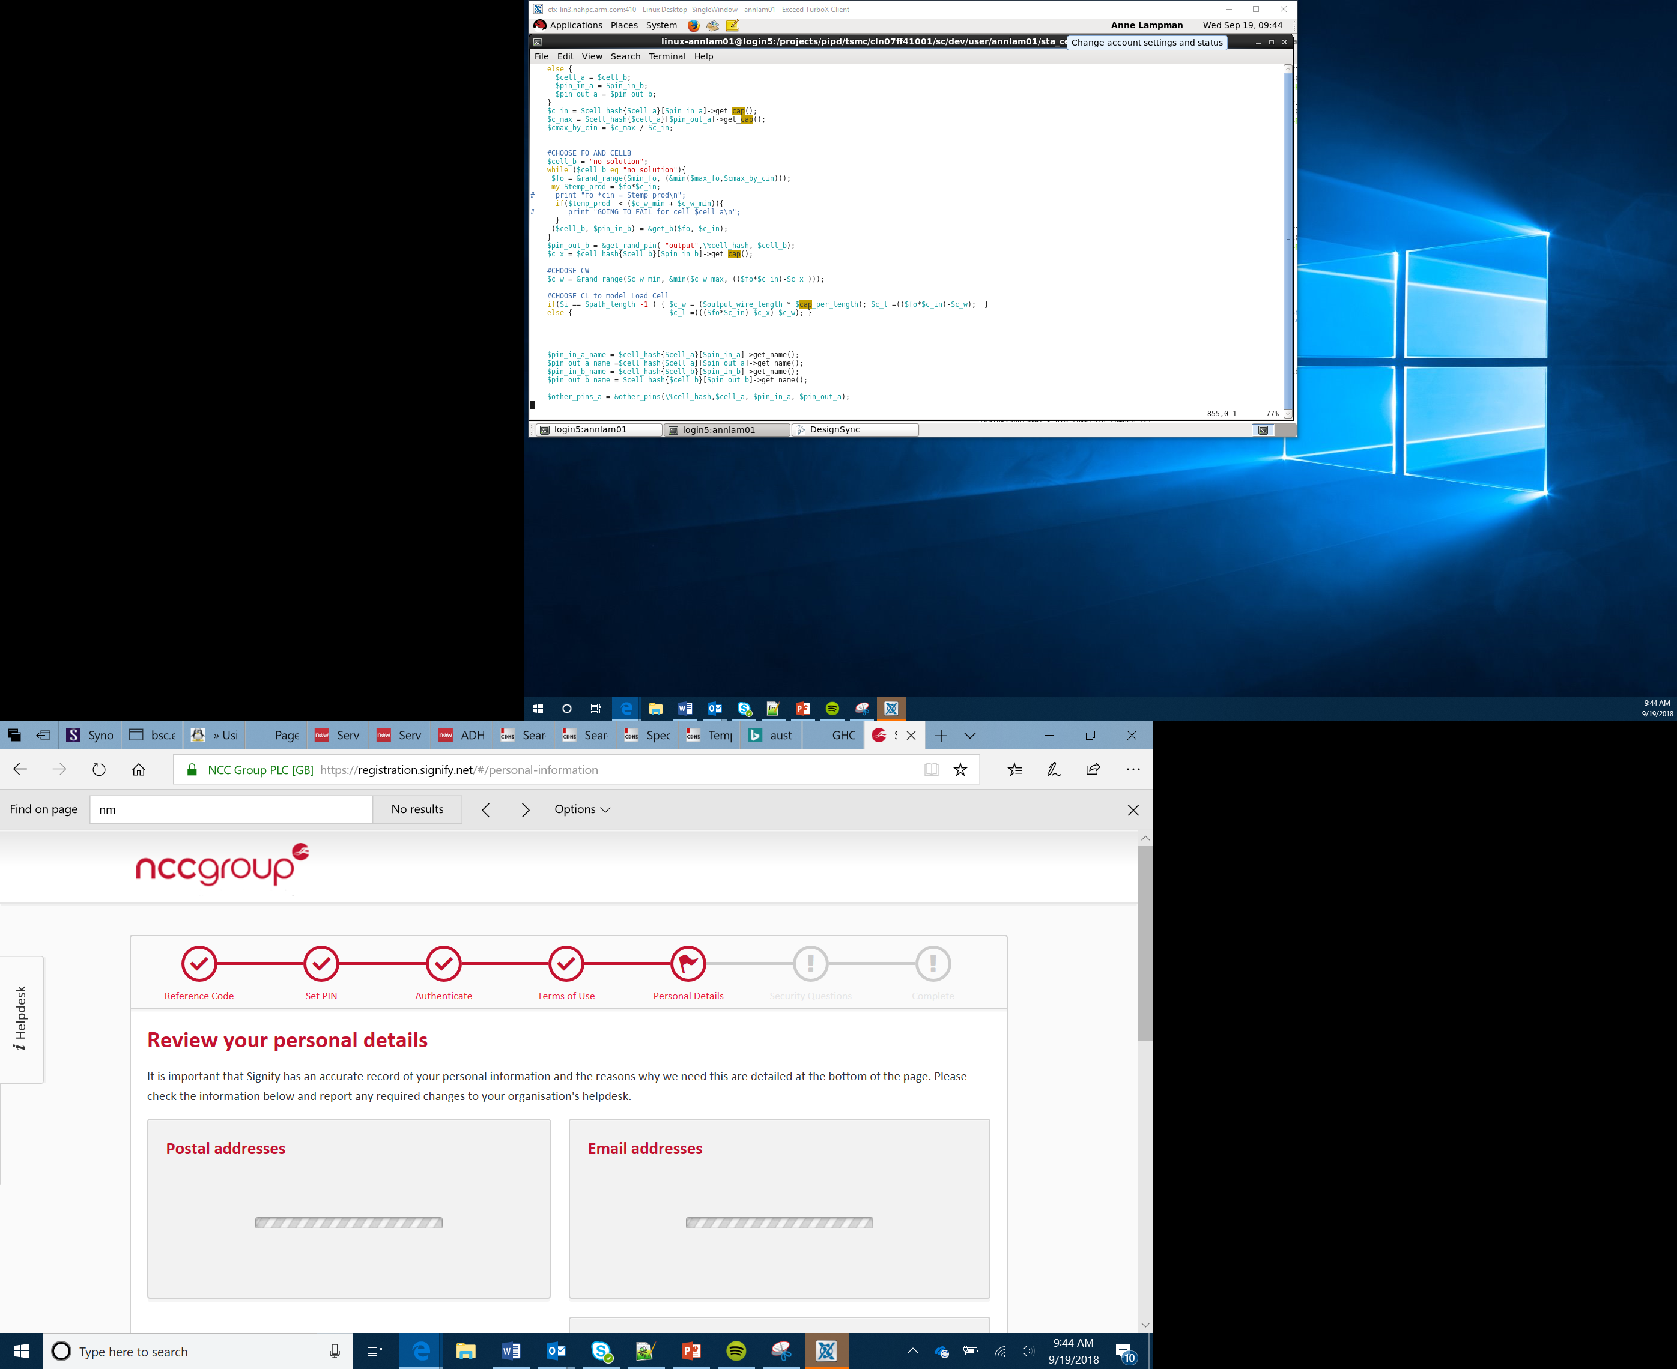

Using All the Pins and Touch Responses
Lesson 20

Slide 2
What You Will Learn
How to attach the edge connector
How to use jumper wire to access the pins
Write a program to respond to each of the pins being touched
Use conductive materials to create buttons and other forms of interaction with the micro:bit
Notes:
Discuss that the micro:bit has a number of pins, can the Learners locate them?

Slide 3
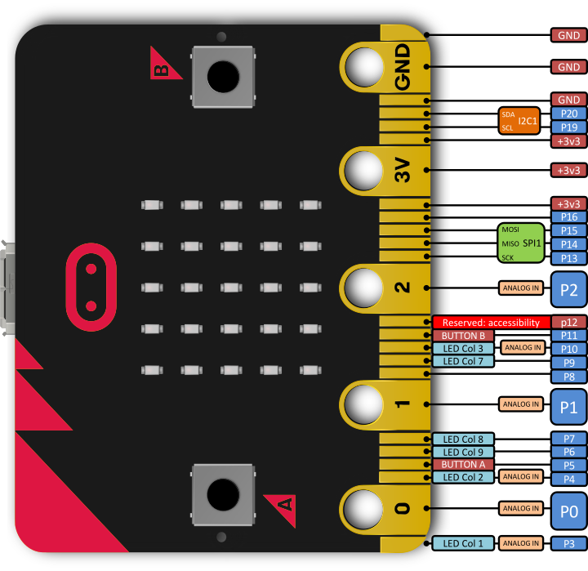
Pins
The pins enable you to add additional input, outputs and control to your micro:bit and programs
For example you can attached a temperature sensor and write a program to respond to the readings
Attach a motor and power it via the 3V pin
Notes:
Discuss that the micro:bit has a number of pins, can the Learners locate them? Talk over some of the pins and what they do, the GND pin, power pins, input and output pins.

Slide 4
25 Additional Pins
The micro:bit also has 25 smaller pins
These pins range from providing:
3v of current
controlling the LEDs
controlling the A and B buttons
Adding a crocodile clip to Pin 5 and joining it to the GND pin, making a circuit, is the equivalent to touching Button A
Notes:
Discuss that the micro:bit has a number of pins, can the Learners locate them? Talk over some of the pins and what they do, the GND pin, power pins, input and output pins.

Slide 5
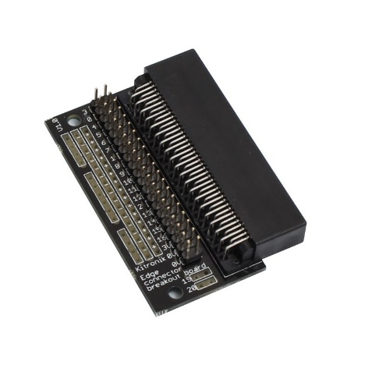
The Edge Connector
The micro:bit a wide range of smaller pins which can be accessed using the edge connector
This board attaches to your micro:bit and provides an individual metal point of contact for each of the pins
Female to male jumper wires can be used to access each of the pins
All the pins are accessible so you can increase the number of inputs, outputs and interactions that the micro:bit and program code can use
Notes:
Explain about the edge connector and get students to connect one to their micro:bit

